Slide 1
AUTOMATIC NUMBER PLATE RECOGNITION SYSTEM

Slide 2
Existing System
The concept of automatic toll collection has been studied since 1992 and is based on the RFID Tags. The research paper titled “Electronic Toll Collection System Using Passive RFID Technology” gives the overview of the toll collection system using RFID. The concept is based on existing toll booths, however human intervention is no longer required. The vehicles will be given a passive tag in the form of a sticker which could be affixed on the windshield, just like in the existing road tax system. Each time the vehicle passes the toll booth, the tag will be read and information will be transmitted to the main computer. The tax amount will be either deducted by prepaid or credited by postpaid. “Automated Toll Collection System Using RFID” in this identification is done with the help of radio frequency. A vehicle will hold an RFID Tag. Reader will be strategically placed at toll plaza. When the vehicle passes the toll naka, the tax
amount will be deducted from his prepaid balance.

Slide 3
INTRODUCTION
Automatic toll collection using Optical Character Recognition (OCR) aims at successfully removing unnecessary traffic delays, faster and reliable processing and transaction of toll tax aiming to go cashless. In this, OCR is widely used technology which converts scanned images of printed text, handwritten text characters into machine encoded text information such as ASCII. It has three major parts: vehicle number plate extraction, character segmentation and OCR. Number plate extraction is that stage where vehicle number plate is detected. The detected number plate is pre-processed and then the result is passed to the segmentation part to segment the individually characters from the extracted number plate. The segmented characters are normalized and passed to an OCR algorithm. At last the optical character information will be converted into encoded text. The characters are recognized using Template matching. The final output must be in the form of string of characters along with comparison of the characters (number plate) with the database for a successful transaction of toll tax.

Slide 4
LITERATURE SURVEY
Automatic Number Plate Recognition (ANPR) System:
Proposed by Shriram Kishanrao Waghmare, A. K. Gulve, Vikas N. Nirgude that automatically recognizes the number plate of the vehicle. In this paper proposed approach is present. It has considered the Indian number plates, where rear follows the number plate standards. This system consist of few algorithm like “Feature based number plate Localization” for locating the number plate,“Image Scissoring” algorithm for character segmentation and proposed algorithm for character recognition using Support Vector Machine (SVM).System can recognize single or double line number plate. An algorithm for license plate recognition (LPR) applied to the intelligent transportation system is proposed on the basis of a novel shadow removal technique and character recognition algorithms. This paper has two major contributions. One contribution is a new binary method, i.e., the shadow removal method, which is based on the improved Bernsen algorithm combined with the Gaussian filter. r. This paper also presents improved techniques for image tilt correction and image grey enhancement.

Slide 5
LITERATURE SURVEY
Automated Toll Collection System Using RFID:
Proposed by Satyasrikanth P, Mahaveer Penna, and Dileep Reddy Bolla Automatic. It is one of the easiest methods used to organize the heavy flow of traffic. When the car moves through the toll gate on any road, it is indicated on the RFID reader that it has crossed the clearing. The need for manual toll based systems is completely reduced in this methods and the tolling system works through RFID. The system thus installed is quite expedient reducing the time and cost of travelers since the tag can be deciphered from a distance.

Slide 6
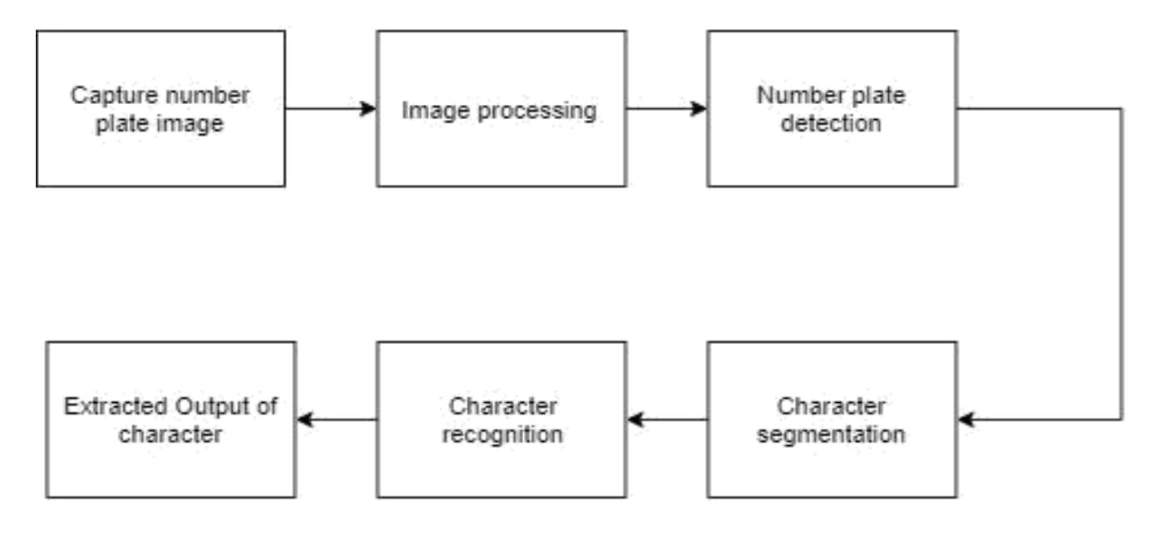
PROPOSED SYSTEM

Slide 7
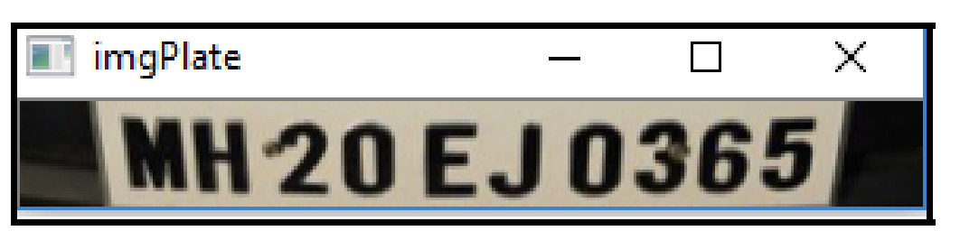

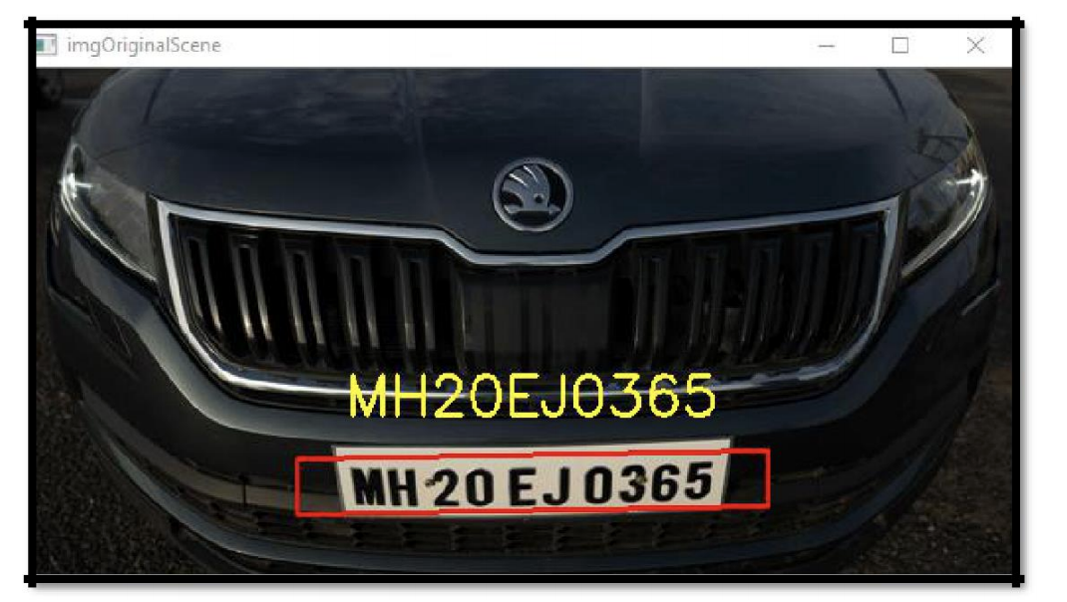
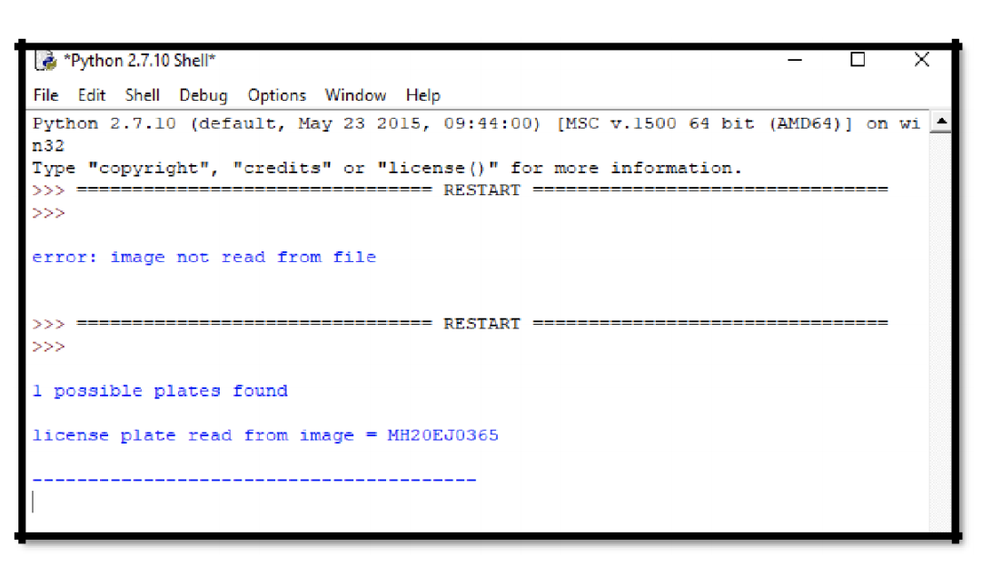
SCREENSHOTS

Slide 8
ADVANTAGES
ANPR systems make use of registration plates that all cars already have, so there is no need to add transmitters or special signs to vehicles which results in saving towards the implementation of the system.
The photograph of the car and the driver can be stored and retrieved if there is a need for evidence in disputes or crime situations.

Slide 9
APPLICATIONS
The various applications are:
Parking
Access-control
Tolling
Border control

Slide 10
CONCLUSION
There is an immediate need of such kind of Automatic Number Plate Recognition system in India as there are problems of traffic, stealing cars etc.
Government should take some interest in developing this system as this system is very economical and eco-friendly, if applied effectively .

Slide 11
CONCLUSION(CONTD.)
It is still not being used in our country but will be prove to be effective.
This change will help in the progress of the nation.

Slide 12
THANK YOU

